Slide 1




Why-Pi
Why and how the Raspberry Pi came to be
Prepared for Jaycar Maker Hub (Sydney) Raspberry Jam, 14th March 2020 Kev Staunton-Lambert pyrmontbrewery.com

Slide 2
Raspberry Pi turns 8! + gestation period of 4 years
I had the pleasure of working alongside Jack Lang at large telco in the UK in the late 1990s - Jack is one of the founders and (retired) trustee of the Raspberry Pi foundation
I’ve also worked with the Raspberry Pi on various projects over the years including some, where I actually got paid!
I’m sharing some of Jack’s story and will try and answer questions about the device, how the software works and maybe help you make it do whatever you want it to do

Slide 3
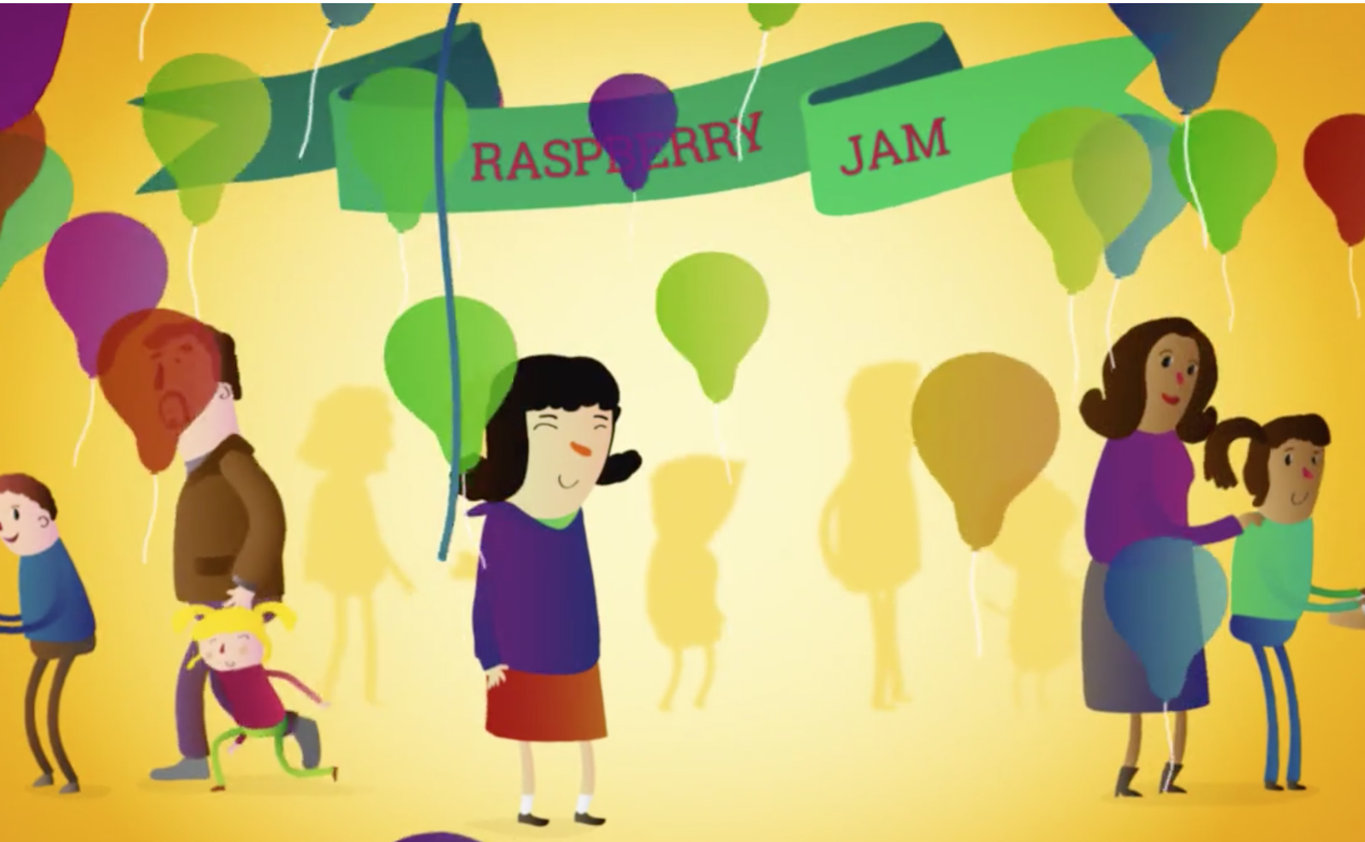
Come to the Jaycar Maker Hub (Central Park, Sydney)
This will be presented at the Raspberry Jam session at 2pm on 14th March - grab a free ticket on Eventbrite

Slide 4
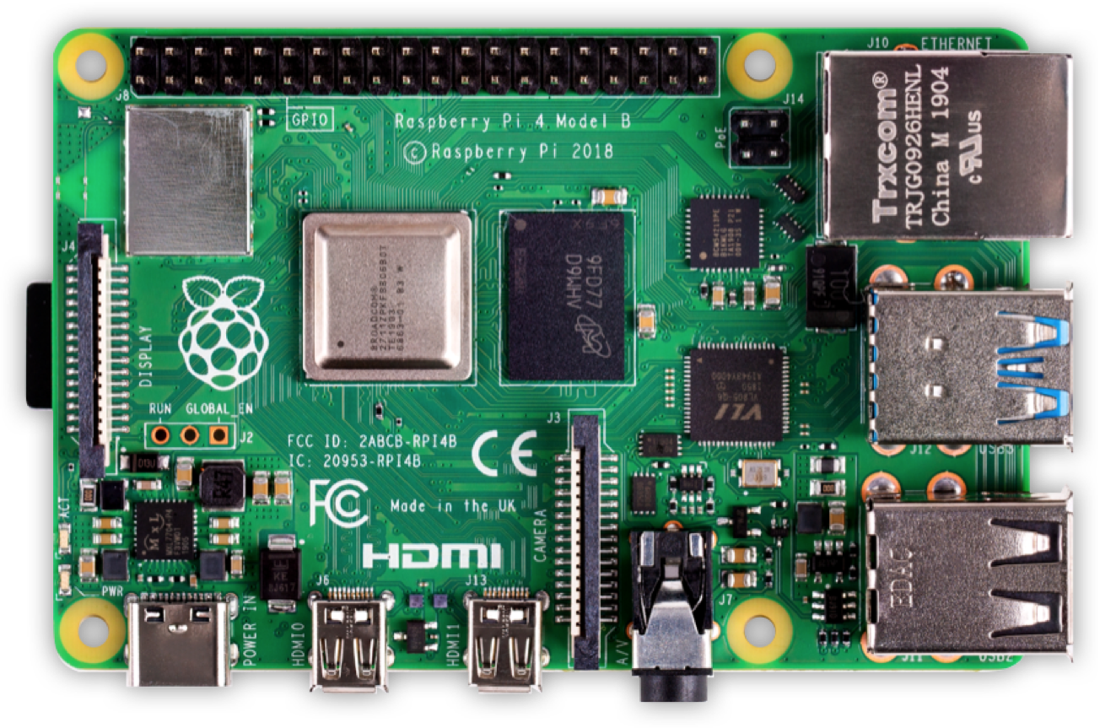
Raspberry Pi - what’s that?
It’s an affordable home computer ~ size of a credit card $35
More so, it’s just the guts of a personal computer - with the intention you’ll take that and go make it whatever you want
It’s real purpose is educational
30 million have been sold worldwide since February 2012!
This is their story...

Slide 5
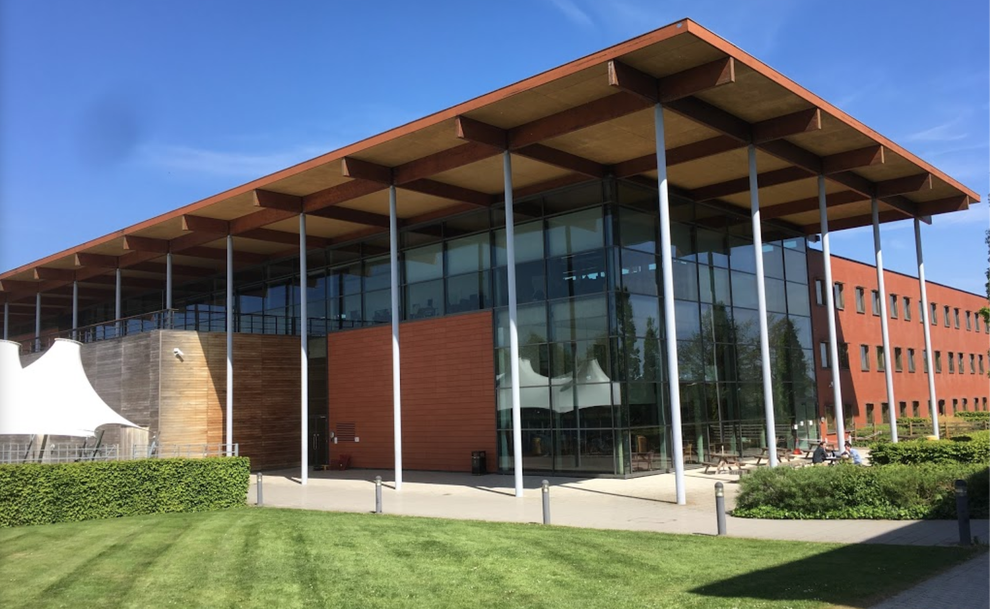
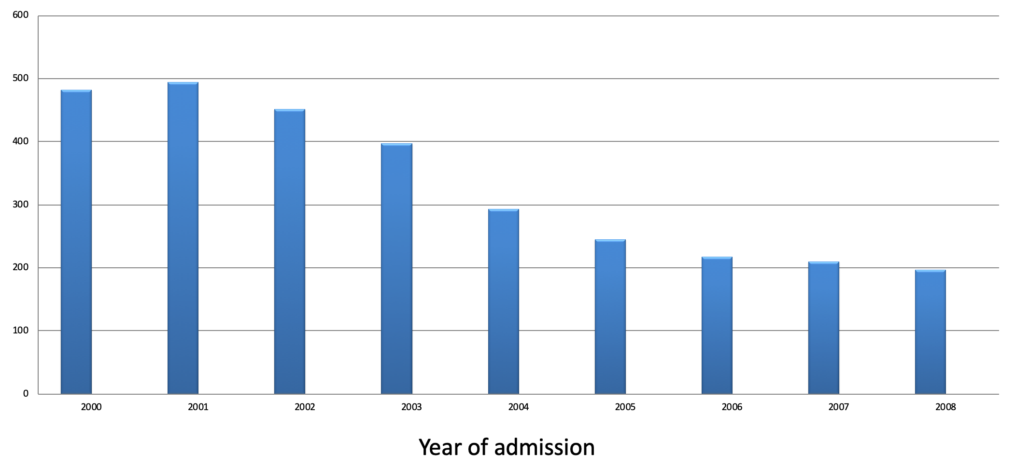
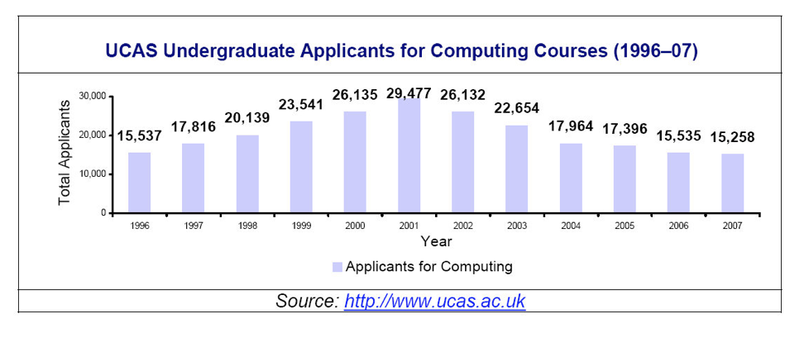
In the beginning...
The University of Cambridge department of Computer Science and Technology had a problem The student numbers were dropping off and their initial general knowledge and experience was lower
Cambridge CompSci admissions

Slide 6
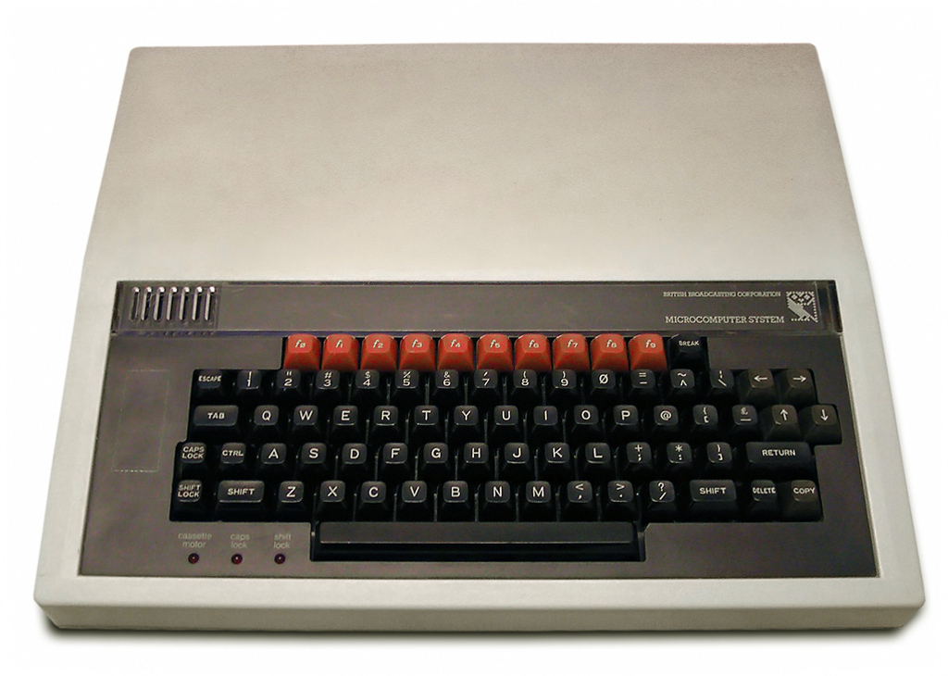
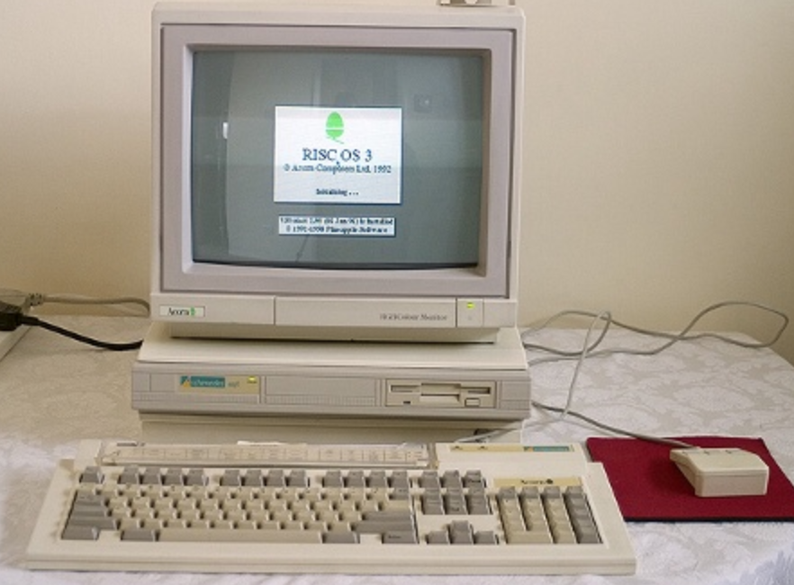
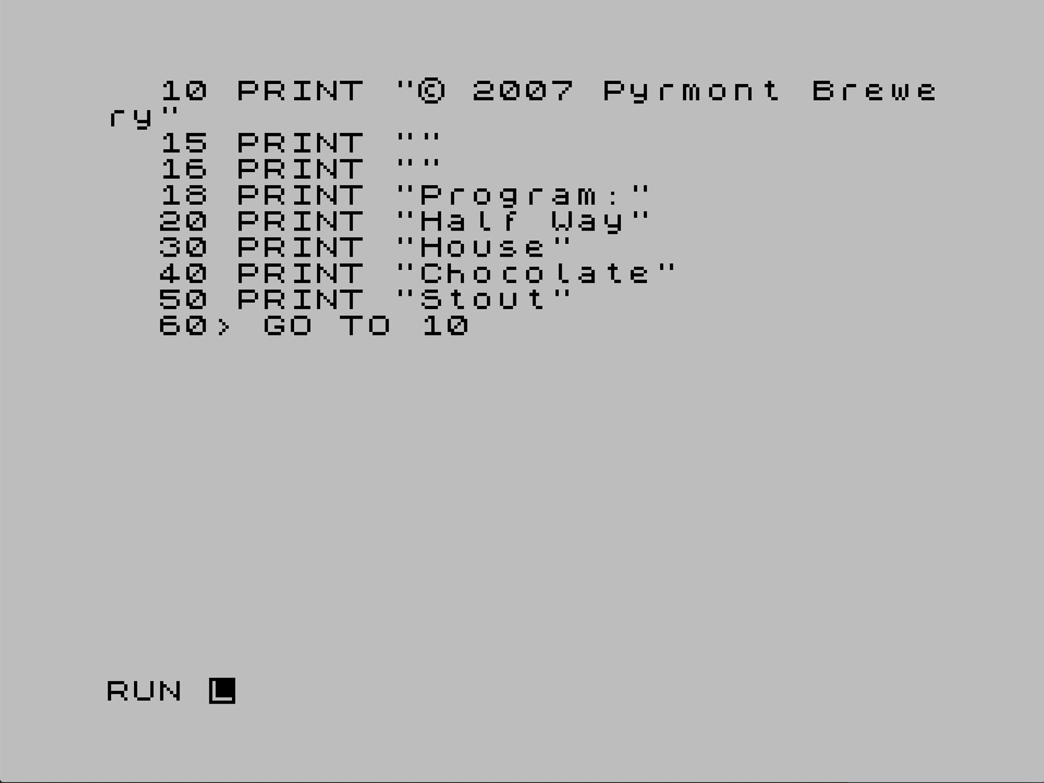
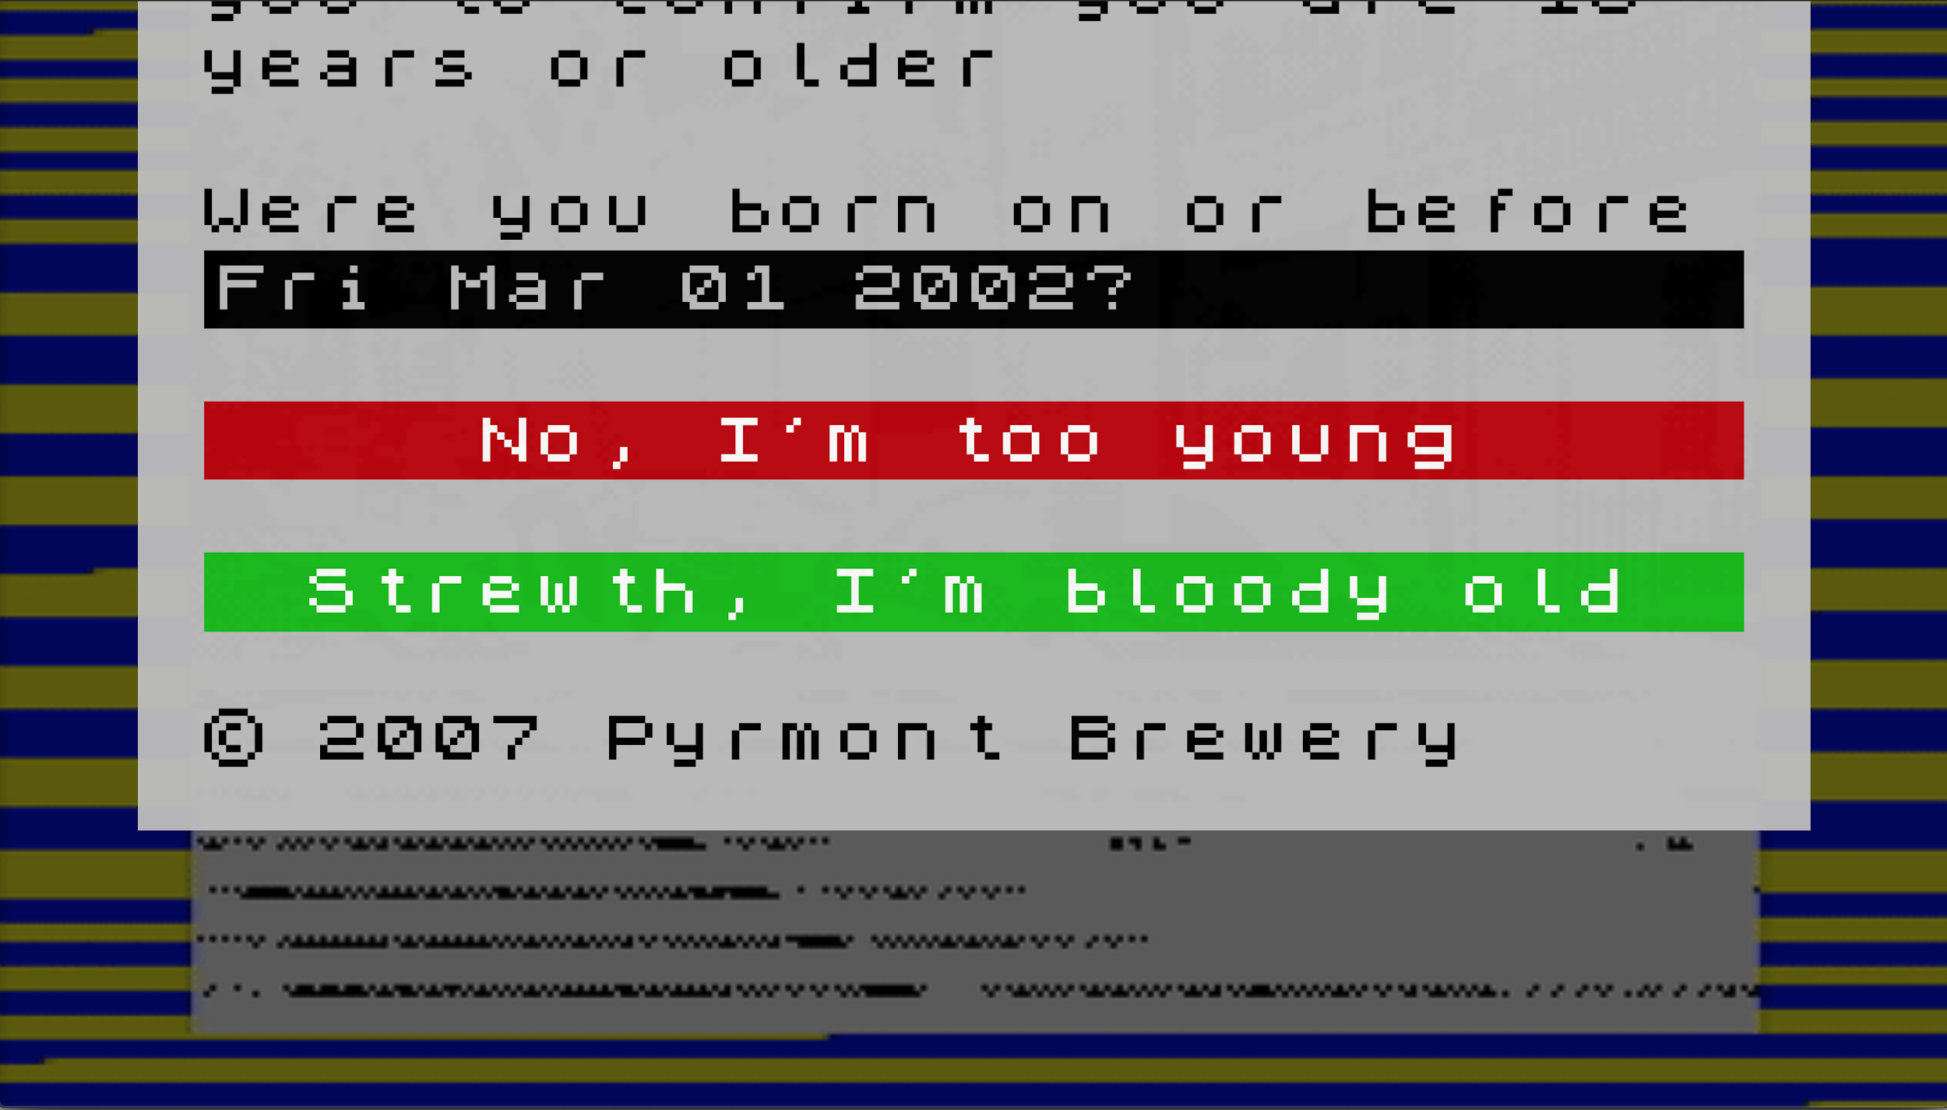
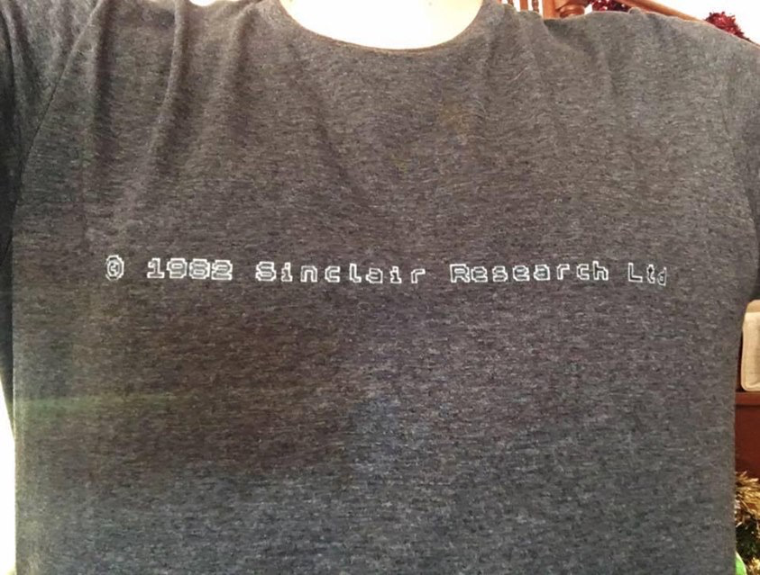
What changed?
In part this was due to how computing was approached in the 80s/90s vs today - kids like me used to actually enjoy programming on the Sinclair ZX80/ZX Spectrum / Electron at home and the BBC Micro / Acorn Archimedes at school
pyrmontbrewery.com

Slide 7
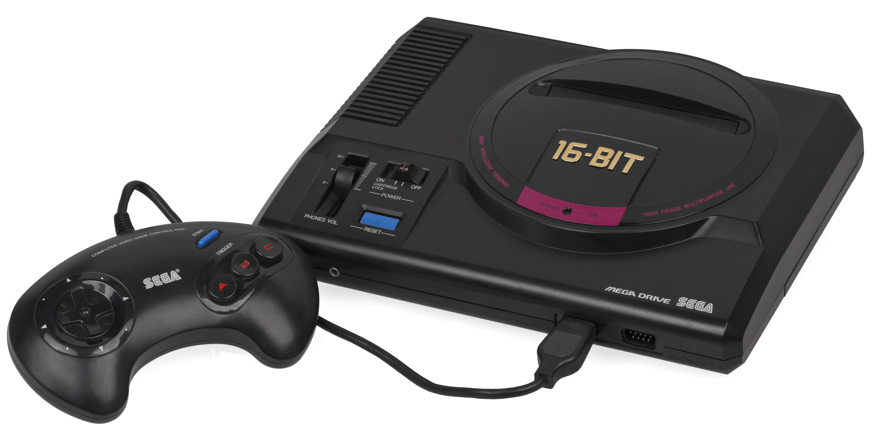
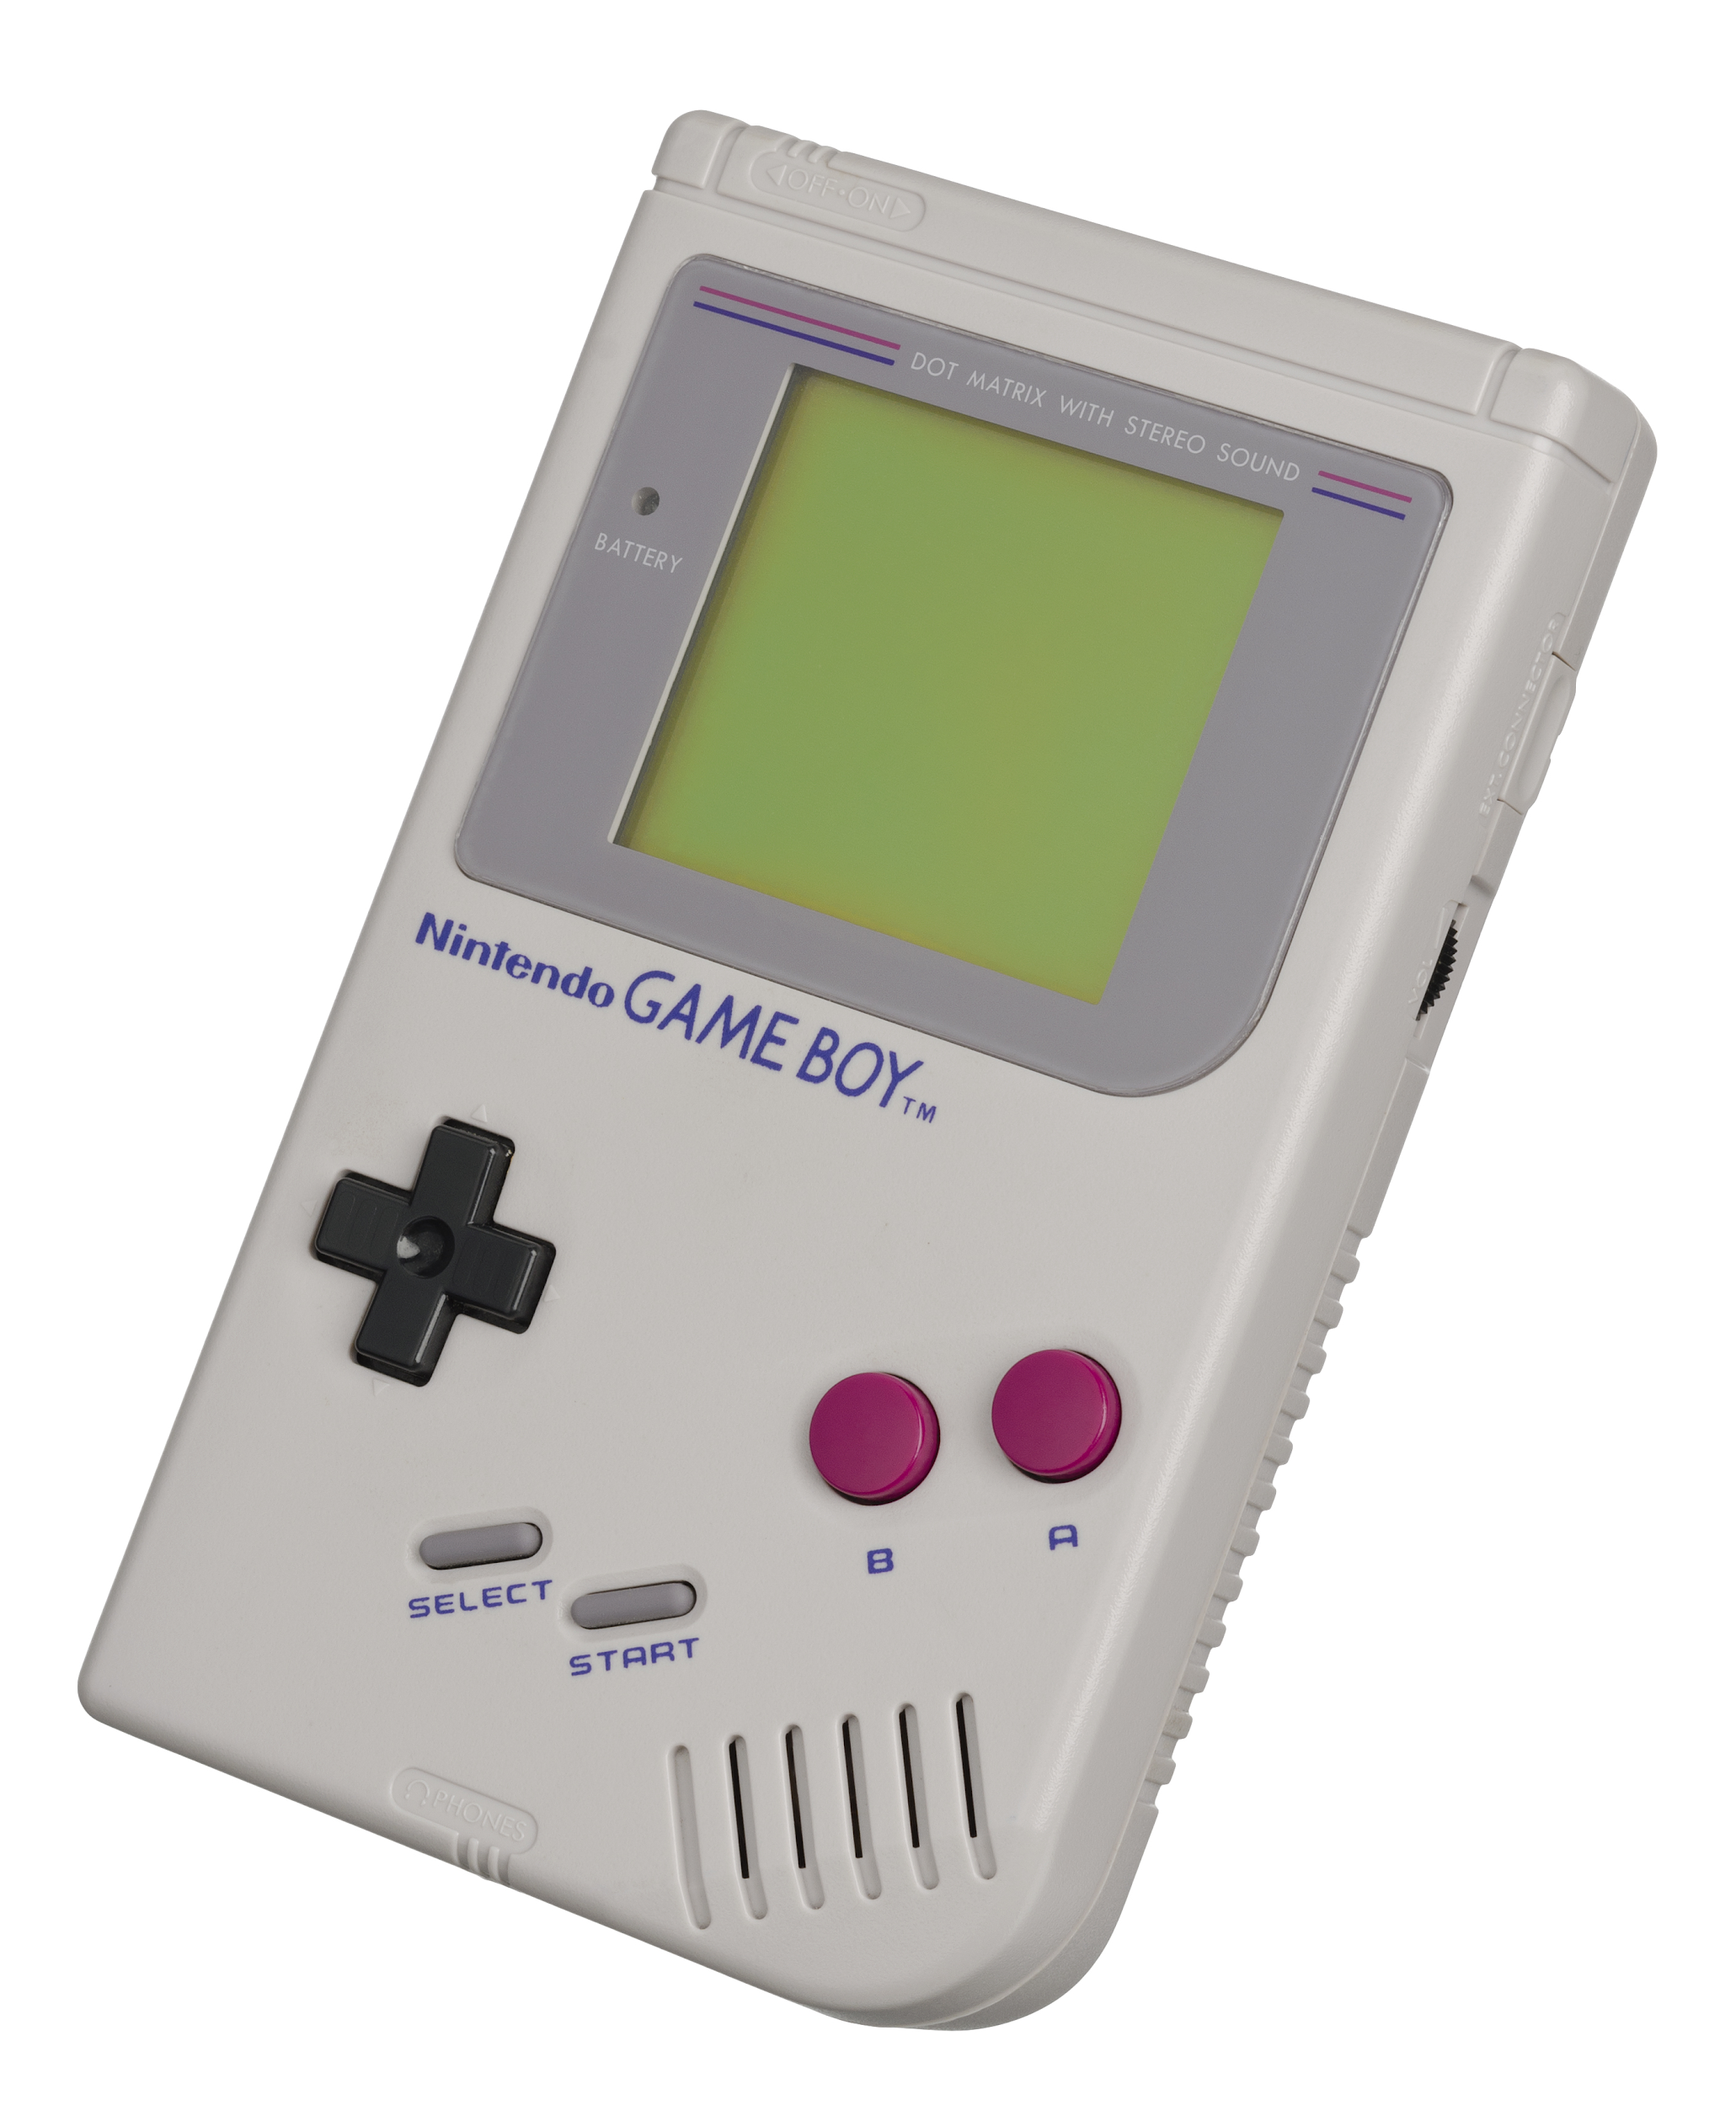
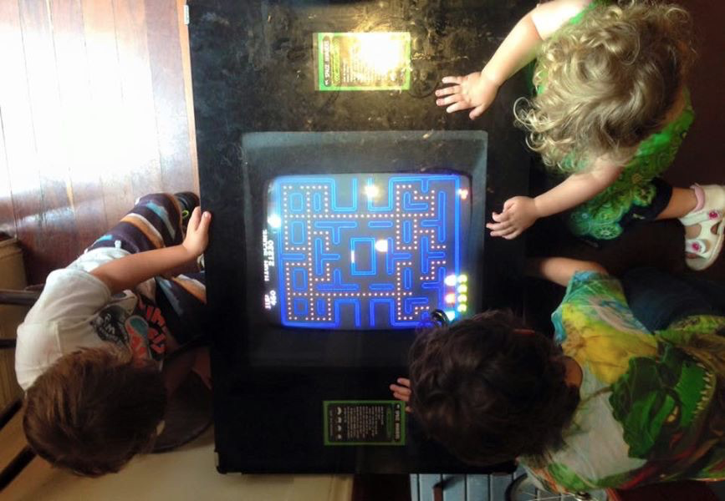
Who’s to blame?
Not entirely fair to pick on individuals but basically closed devices like games consoles, phones and tablets come with significant obstacles and a steep learning curve to get to a point where you can actually be programming them
“To gain access to a command line, you have to download software, It has to occur to you to do it.” [Mullins]

Slide 8
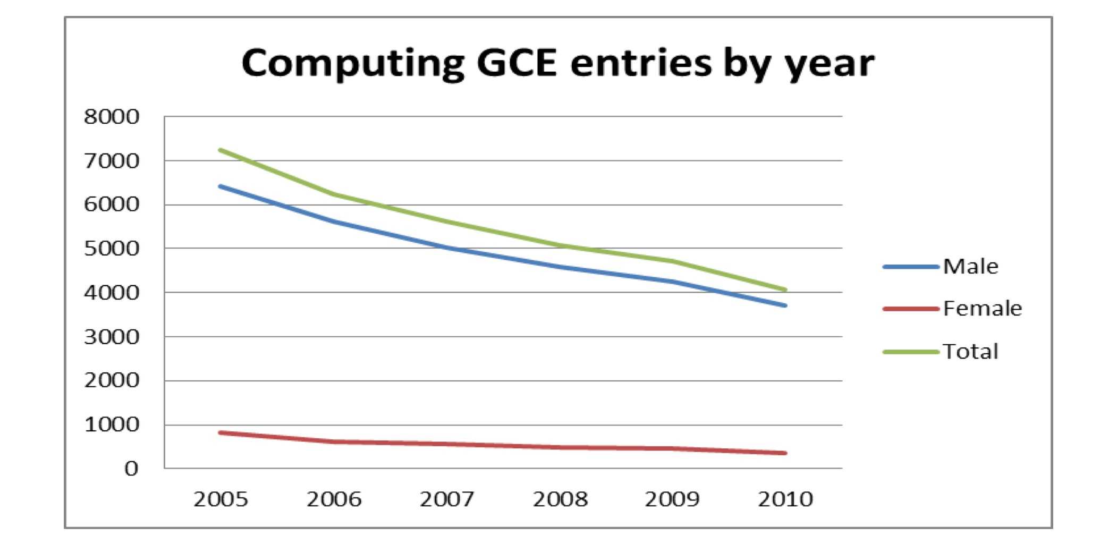
Why that's not so good...
This all leads to less enthusiasm in the subject and some complacency that everything kind of seems ok in the industry
I myself was the only candidate to sit the (HSE equiv) exam in my school
I wasn’t really taught programming/coding that was largely up to me

Slide 9
Raspberry Pi Foundation to the rescue!
“promote the study of computer science and related topics, especially at school level, and to put the fun back into learning computing”
UK registered charity (1129409) Not for profit! Income £31.5M - Spending £27.9M (31 December 2018)

Slide 10
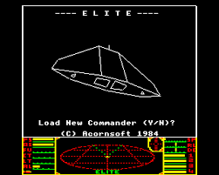
Raspberry Pi Foundation - who are they
Today ~ 135 people but in Feb 2008 Jack Lang wrote the 𝜋 manifesto - meanwhile - Eben Upton had been experimenting with low cost designs (with Broadcom) and David Braben was thinking about educational software to increase the flow of games programmers (he wrote Elite)
The six trustees of the charity we really must thank are (Dr’s): Jack Lang, Eben Upton CBE, David Braben OBE, Prof Alan Mycroft, Rob Mullins + Pete Lomas FReng

Slide 11
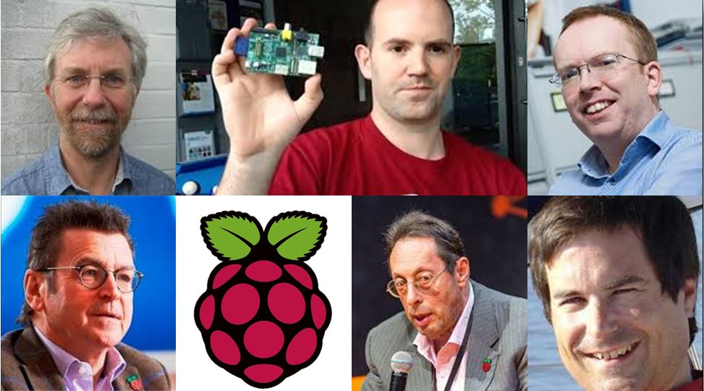
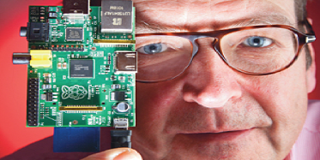

Raspberry Pi Foundation - who are they
PiPeople
Alan Mycroft Eben Upton
Rob Mullins
Pete Lomas
Jack Lang
Dave Braben
Alan
Eben
Rob
Pete
Jack
Dave

Slide 12
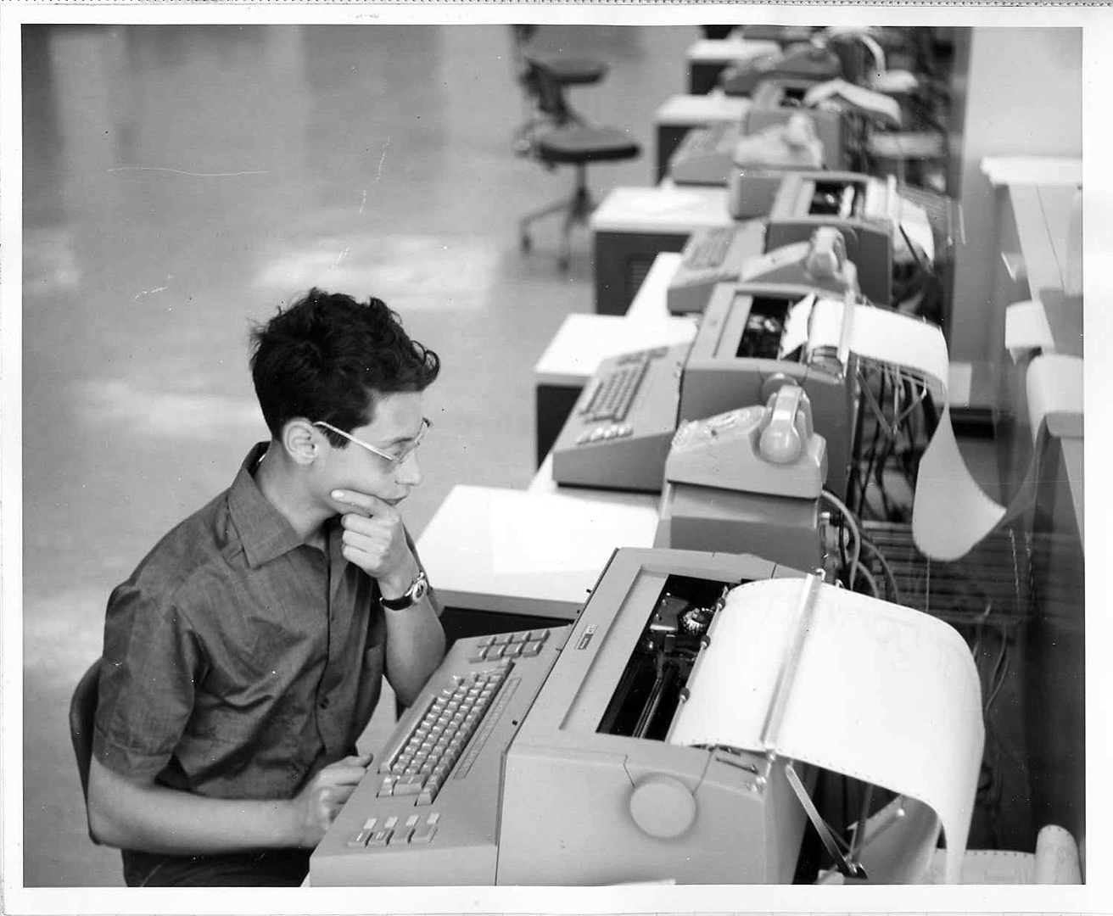

Raspberry Pi Foundation - Jack
I worked with Jack at ntl: (Virgin Media UK) he really is quite remarkable, witty and extremely knowledgeable
Lectures Entrepreneurship at Cambridge University
Knows bloody everyone Has a fireworks license! Taught me to network

Slide 13
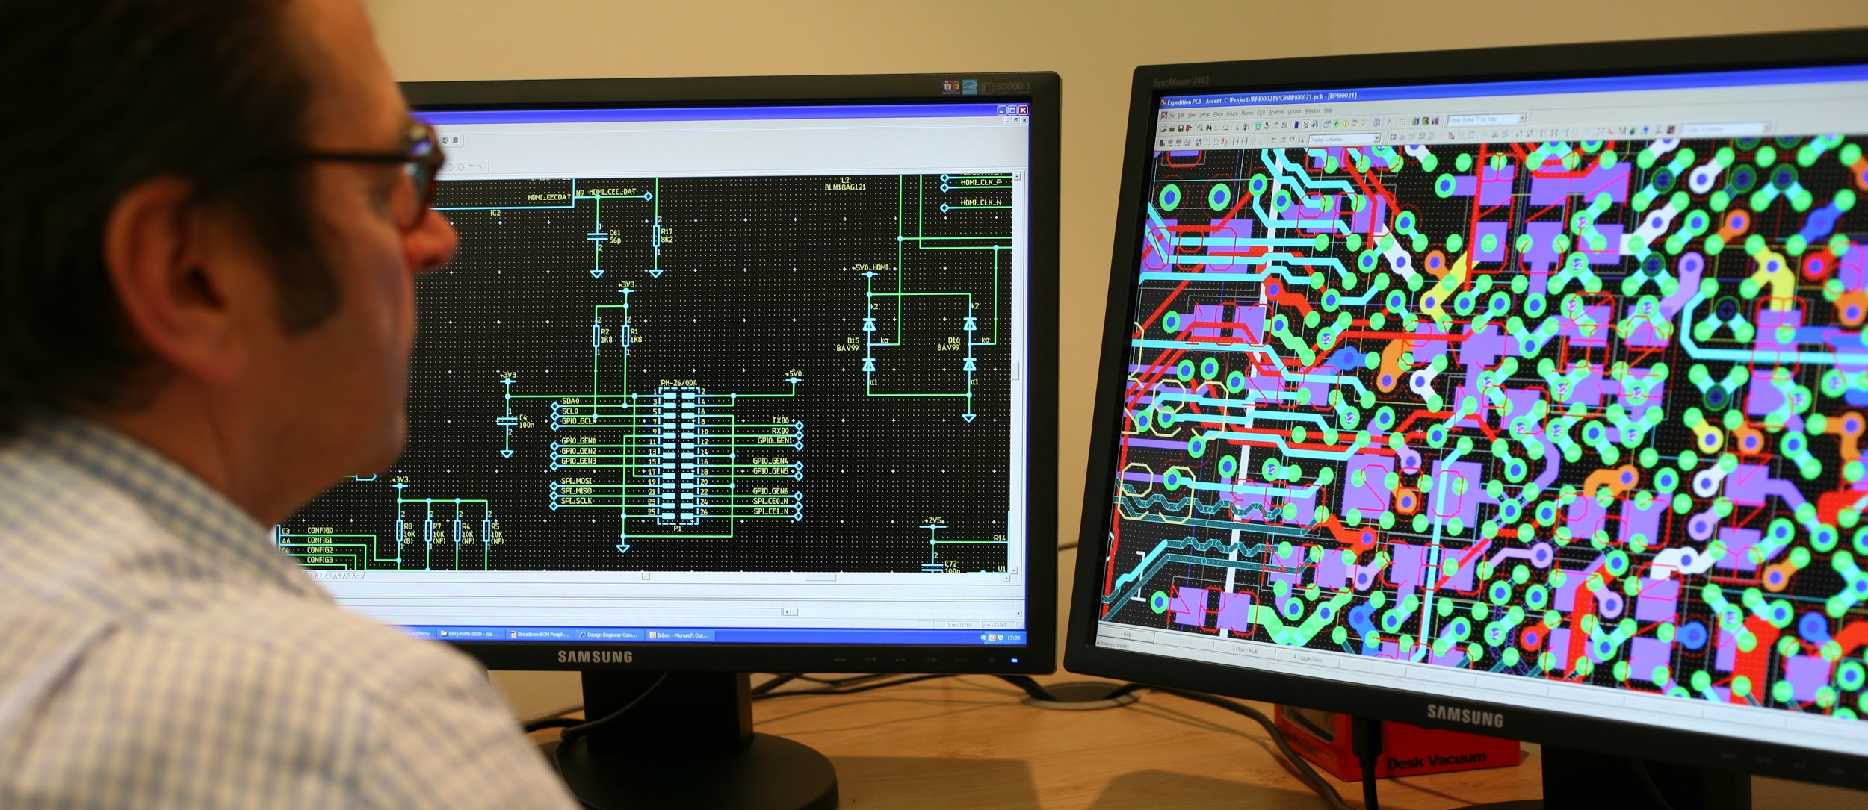
Raspberry Pi Foundation - PCB design
This is
Software Pete is using here is Mentor Graphics Expedition PCB

Slide 14
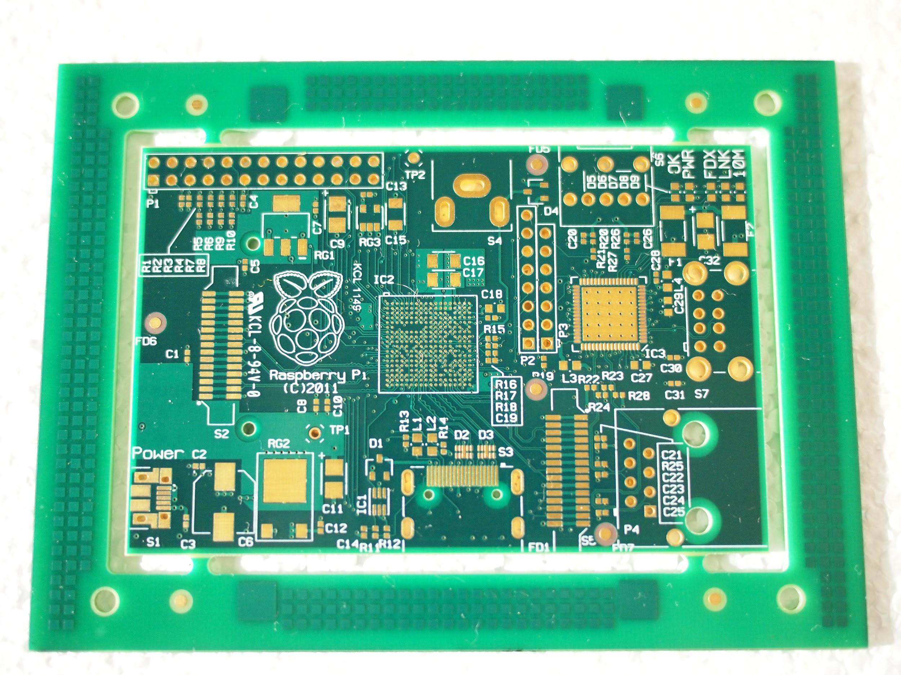
Raspberry Pi Foundation - first PCB born
< A naked Pi
This photo is actually the first ever production Raspberry Pi board!
Manufactured in China (via Hong Kong distributor)
(thanks Pete Lomas for the photo)

Slide 15
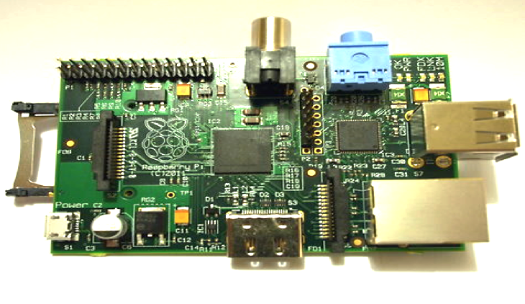
Raspberry Pi Foundation - with clothes on

Slide 16
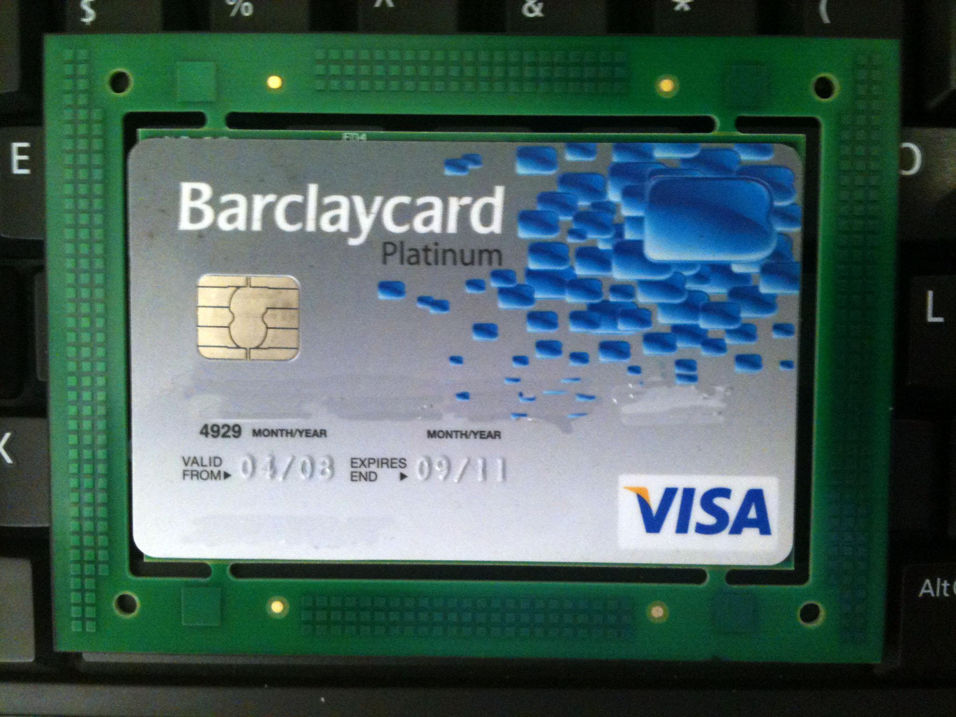
Raspberry Pi Foundation - first PCB
Pete checking it actually is the size of a credit card as was promised

Slide 17
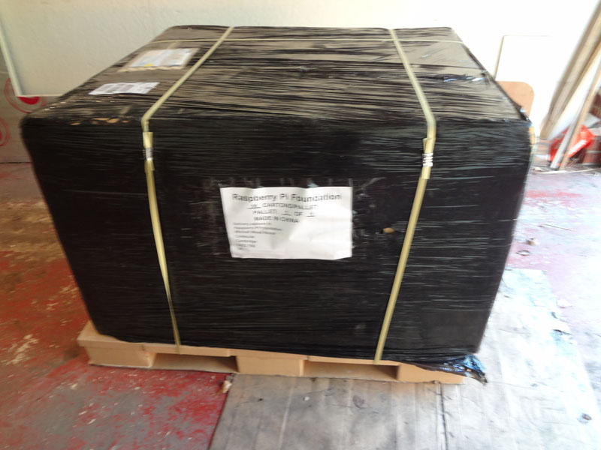
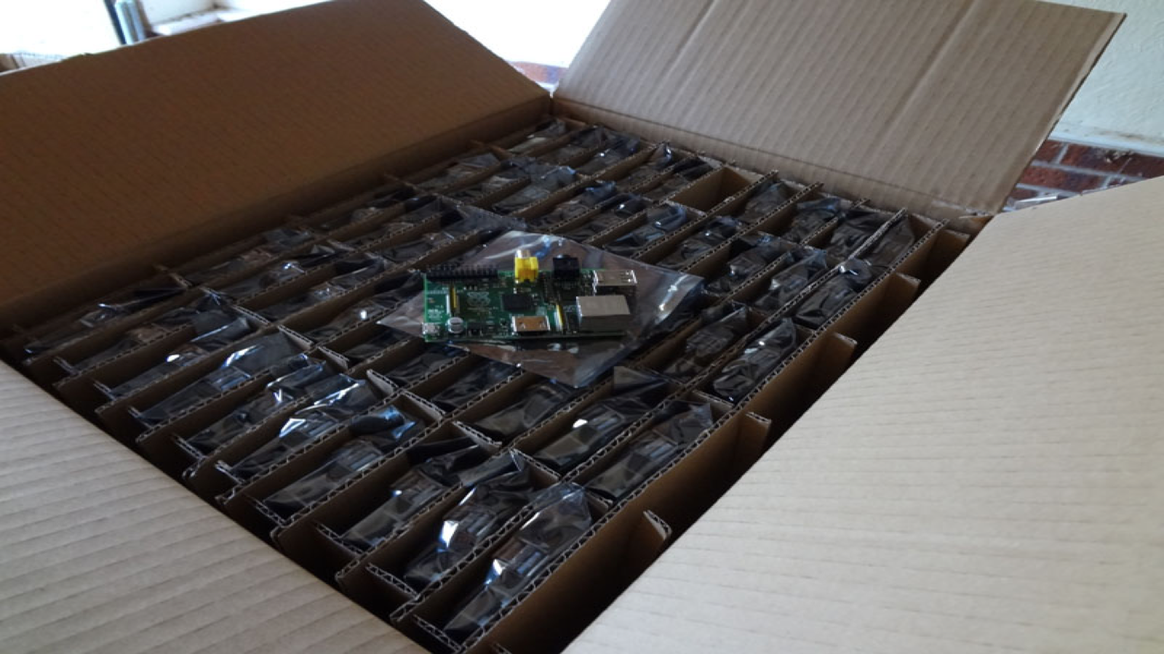
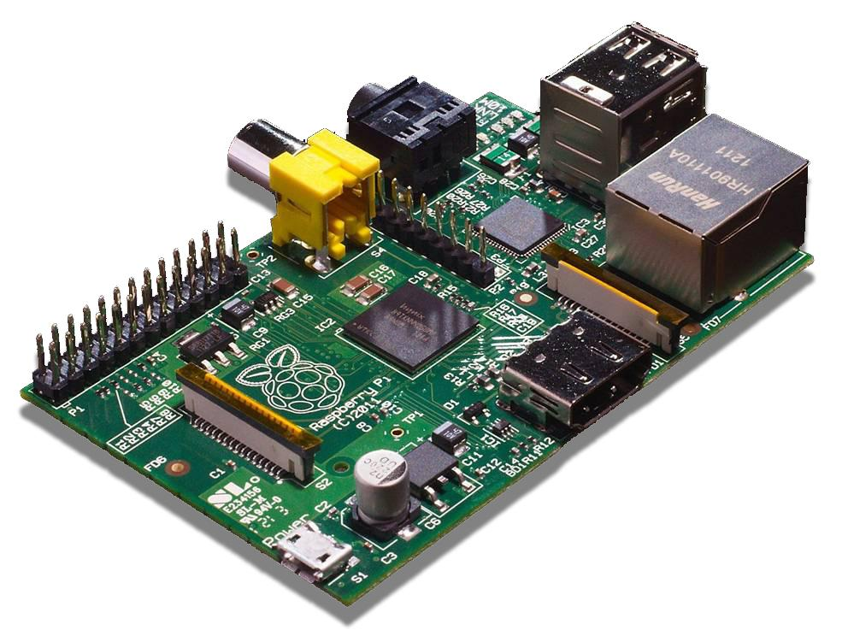
Raspberry Pi Foundation - first 10,000 units
This is the initial 10,000 units that was going to be “about enough" (unpacking ceremony in Jack’s garage)

Slide 18
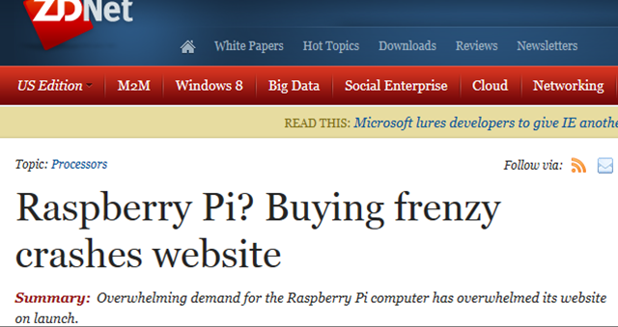
Raspberry Pi Foundation - eh oh!
“we accidently sold a million and it was all a bit embarrassing” [Lang]
With orders increasing quickly (> 350K) - the 6 part time trustees can’t keep up - a separate company “Raspberry Pi Trading*” was set up 29th Feb 2012 to maintain the supply
Fix, grant licenses RS and Premier Farnell (element14) to manufacture and distribute
* trading, fully owned by the foundation, Sony (Wales) ‘made in UK’

Slide 19

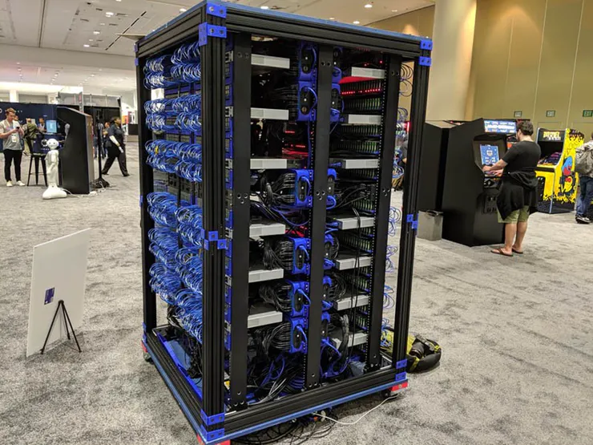
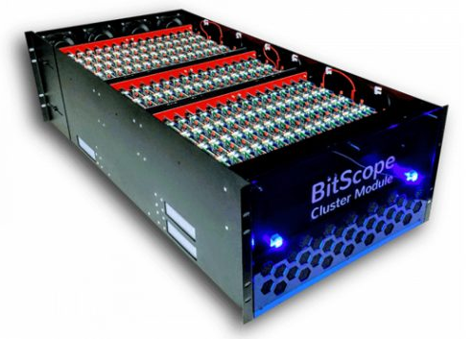
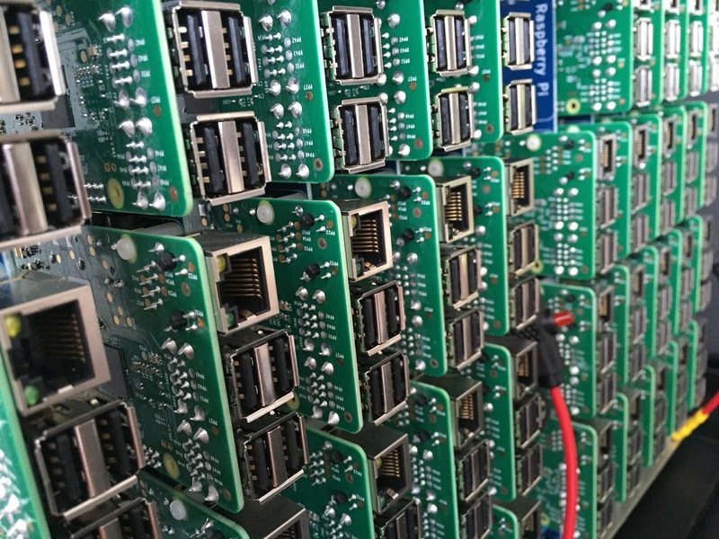
Raspberry Pi Foundation > 30 million units
Makes original estimate out by about 3000x :-)
So who’s buying them? Hobbyists of course... but also can be used in larger clusters - which makes super computing affordable - all sorts of things requiring high CPU/GPU computation / modelling more achievable

Slide 20
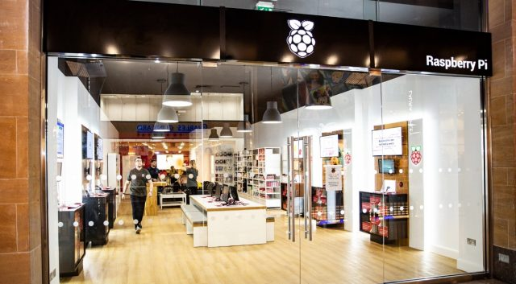
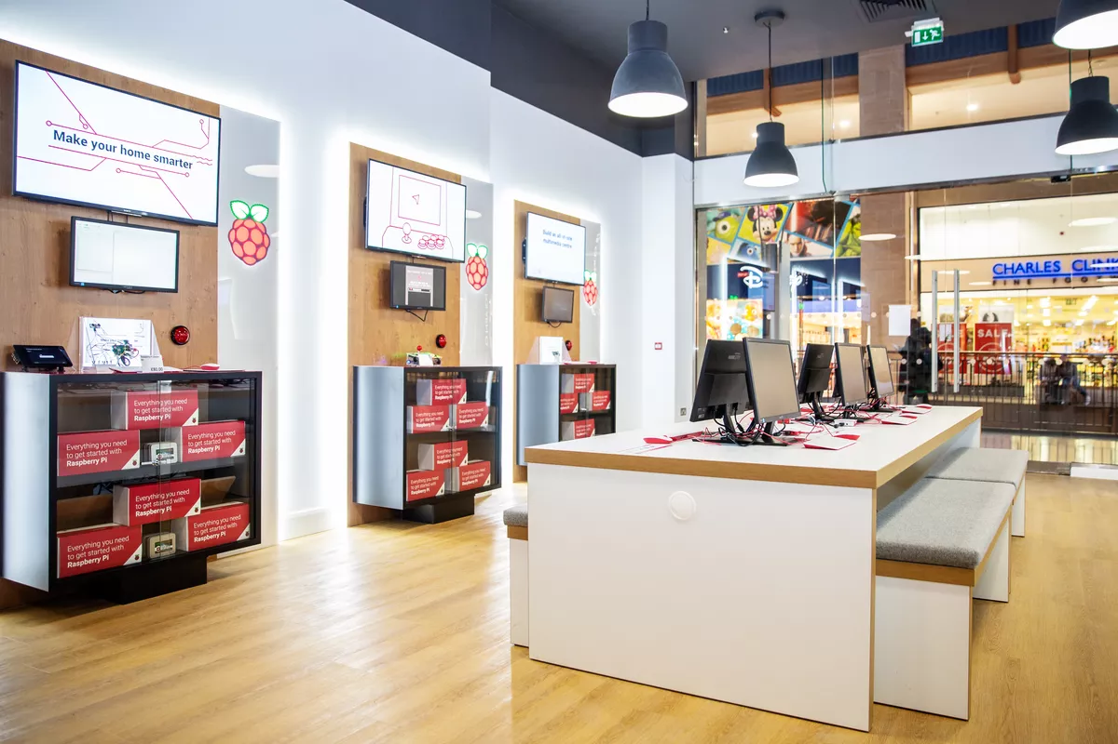
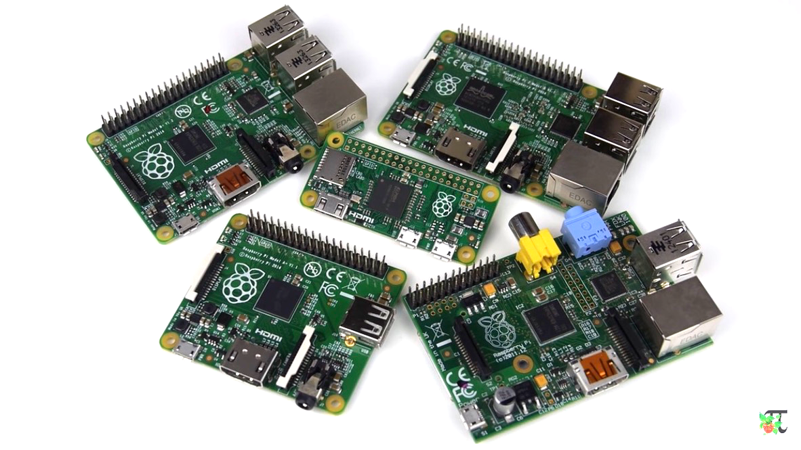
Raspberry Pi Foundation - now also a shop!
You’ll find this today in downtown Cambridge (UK) The Raspberry Pi Store - Grand Arcade Shopping Centre

Slide 21
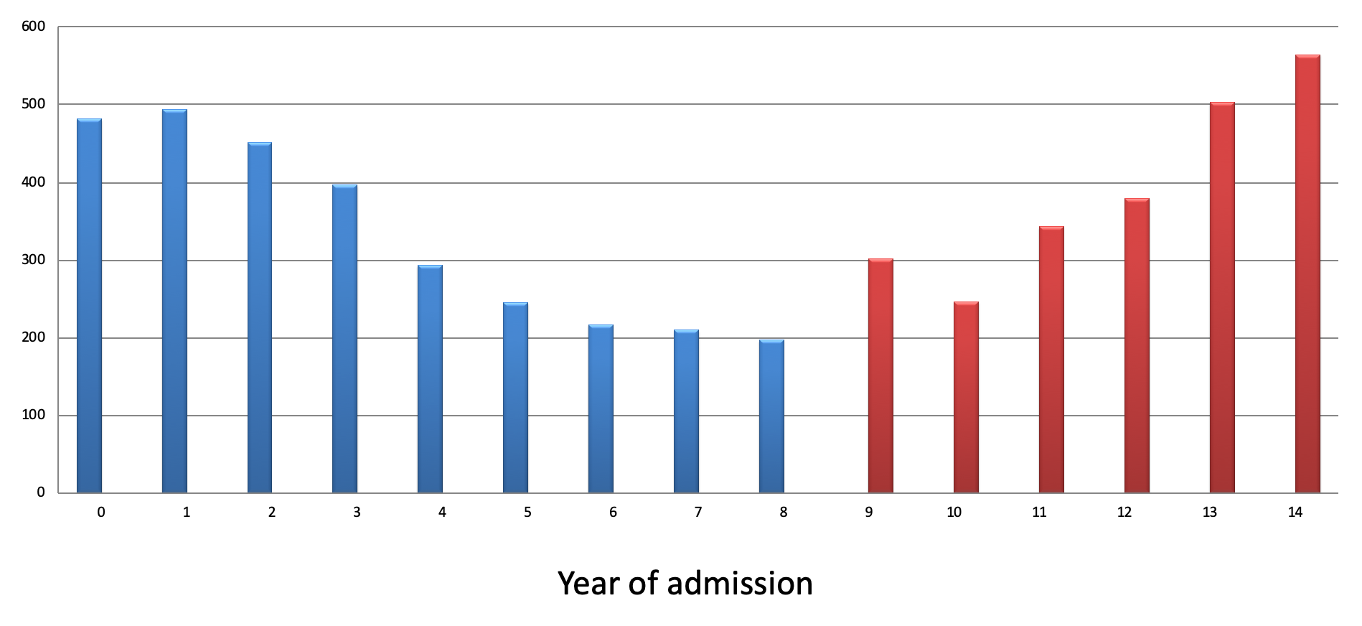
Raspberry Pi Foundation - the best bit
What it’s really about... CompSci students are back! Cambridge had 1,307 applications in 2018 (vs only 197 in 2008)

Slide 22
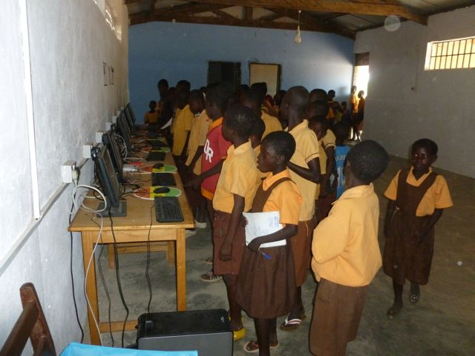
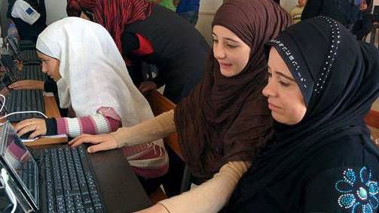
Raspberry Pi Foundation - further kudos
Also Pi’s are empowering many remote communities to be better educated in computer science and general
RachelPi are educational air drops in areas of poor connectivity runs as hotspot/web server hosting Wikipedia snapshot etc

Slide 23
Get going with a Raspberry Pi (headless setup)
Copy the Raspbian Linux distribution .iso file to an SD card $ sudo dd if=/dev/rdisk1 bs=1m | wget https://downloads.raspberrypi.org/raspbian_full_latest
You don’t actually a need keyboard, mouse or a monitor ;-) $ touch /Volumes/boot/ssh $ vi /Volumes/boot/wpa_supplicant.conf country=AU ctrl_interface=DIR=/var/run/wpa_supplicant GROUP=netdev update_config=1 network={ ssid="YOUR_WIFI_NAME_BSSID" psk="YOUR_WIFI_PASSWORD" } $ sudo apt install realvnc-vnc-server realvnc-vnc-viewer

Slide 24
Set your expectations up realistically
The Raspberry Pi is not a PC, but is pretty powerful for its size
Cut down versions of Broadcom SoCs datasheets available Broadcom BCM2711B0 quad-core A72 (v8-A) 64-bit 1.5GHz 4 Gigabyte LPDDR4 RAM
Wi-Fi (5G 802.11ac + 2G 802.11b/g/n) Bluetooth 5.0 with BLE (low energy)
(make sure your USB PSU power supply is 2.5A or higher)

Slide 25
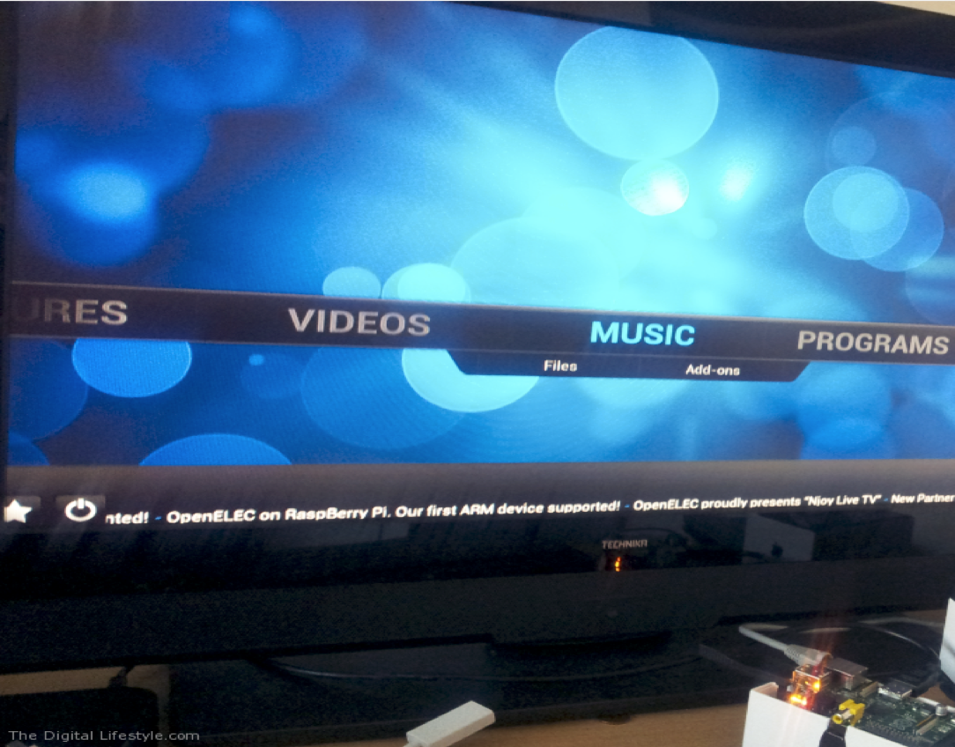
4K Video capabilities (VideoCore VI @ 500MHz)
Always been good - earliest model comparable to first Xbox - Roku boxes (e.g. Telstra TV) are part Raspberry Pi
XBMC also ruans, Netflix too! (at least until the DRM kicks in) Frame buffer tech comes from latest Broadcom VideoCore V
4K H.265 (HEVC) hardware decode * (60fps) HD H.264 hardware decode * (1080p60fps) OpenGL 3.0 3D Graphics (and GLES2) Supports dual 4K HDMI displays!
* needs additional (low cost) license to unlock this feature

Slide 26

What can I do with my Raspberry Pi?
Sightly controversial comment - but - creating a website is kind of programming, but in traditional terms, really it’s not
Yes of course do learn Flutter/React with JavaScript but also maybe also look at WebAssembly too Challenge yourself to maybe see how you might do it in C or Rust And everyone must learn Python Why? Like lego, can bind anything you can make!
Pi =

Slide 27
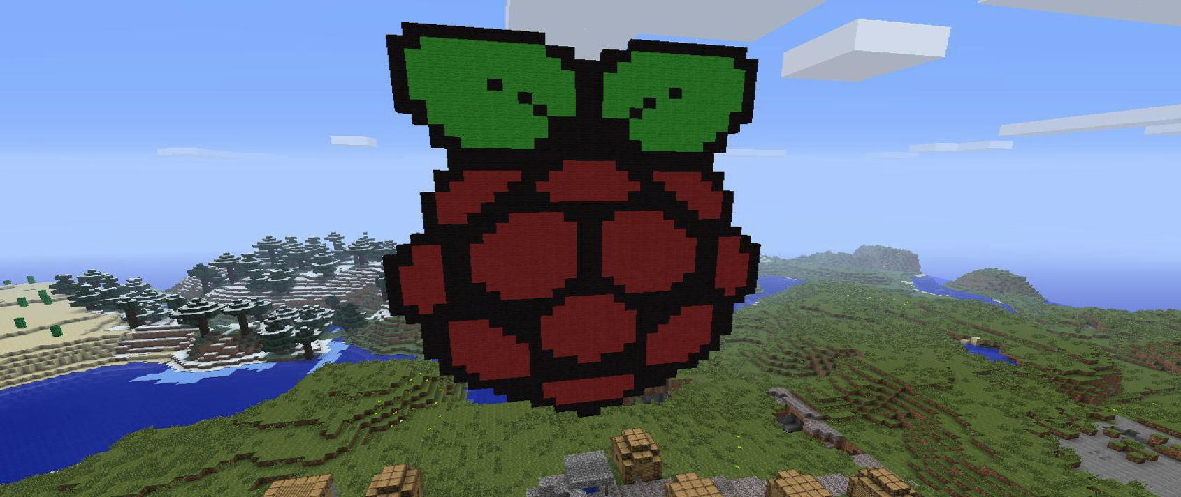
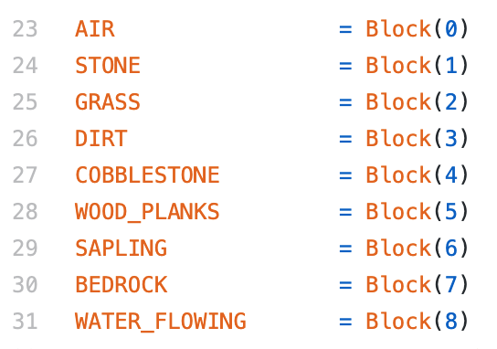
Maybe write a Minecraft (Python) mod
https://projects.raspberrypi.org/en/projects/getting-started-with-minecraft-pi
from mcpi.minecraft import Minecraft mc = Minecraft.create() x, y, z = mc.player.getPos() DIAMOND = 57 mc.setBlock(x + 1, y, z, DIAMOND)

Slide 28
Not just software - Connect up to other hardware
By design the Raspberry Pi is easily connectable via USB, Wi-Fi, Bluetooth, Ethernet and...
... has 28x user GPIO supporting various interface options Up to 6x UART (serial port signalling, which includes USB too) Up to 6x I²C (Inter-Integrated Circuit serial bus) Up to 5x SPI (Serial Peripheral Interface bus) 1x SDIO interface (SD card) 1x DPI (Parallel RGB Display) 24-bit RGB24 (8 bits for red, green and blue) or RGB666 (6 bits per colour) or RGB565 (5 bits red, 6 green, and 5 blue) 1x PCM (pulse code signal modulator - sample analog signals in digital form) Up to 2x PWM channels (pulse width modulated signals) Up to 3x GPCLK outputs (General Purpose Clock pins - output a fixed frequency)

Slide 29
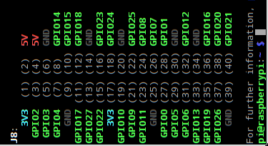
Connect up to other hardware devices - GPIO
General Purpose In/Out pins - 40 pin header at the top of the board (can use regular IDC ribbon cable etc to attach to breadboard etc or make a 'hat' board)
3.3V high
0V low
GPIO2/3 fixed pull-up resistors others are software configurable
import pigpio pi = pigpio.pi() pi.write(19, int('True')) pi.stop()

Slide 30
Connect up to other hardware devices - SPI bus
I2C + SPI serial buses (warning 3.3V not 5V) SPI allows for up to five attached devices I2C allows up to six addressable devices
Pin19 = SPI MOSI (SDO) Pin21 = SPI MISO (SDI) Pin23 = SPI SCK (clock) Pin24+26 = SPI CE0/CE1 = SS (shift select)
Software is off by default, run raspi-config to enable the devices /dev/spidev0.0 and /dev/spidev0.1
import spidev spi.open(0 bus, 1 device) spi.xfer2([0x1234 some message])

Slide 31
Connect up to other hardware devices - I²C
Inter-Integrated Circuit - 2 wire addressable serial bus Up to 6 buses - any number of addressable devices (also HDMI)
Pin3+27 = I²C SDA 0/1 (serial data) Pin4+28 = I²C SCL 0/1 (serial clock line)
import smbus
channel = 1 # 1 is connected to the GPIO pins addr = 0x60 # for your device
# Register addresses reg_write = 0x40
bus = smbus.SMBus(channel) # initialize bus.write_i2c_block_data(addr, reg_write, msg)

Slide 32
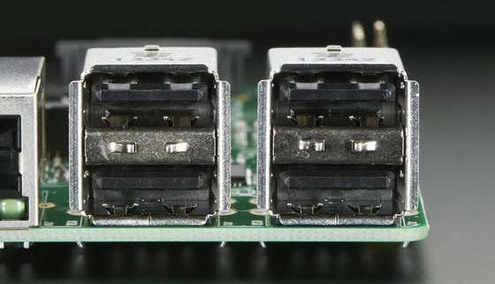
Connect up to other hardware devices - USB2/3
Universal Serial Bus - many USB devices out there with standard drivers, Pi4 has 2 x USB2 and 2 x USB3
Four transfer types: bulk (HDD), interrupt (mice/keyboard HID), isochronous and control endpoints
import usb
args["idVendor"] = 0x16c0 # uDMX args["idProduct"] = 0x5dc # uDMX device = usb.core.find(**args)
device.ctrl_transfer(type, req) device.write(1, 'DMX_CH1=RGB')

Slide 33
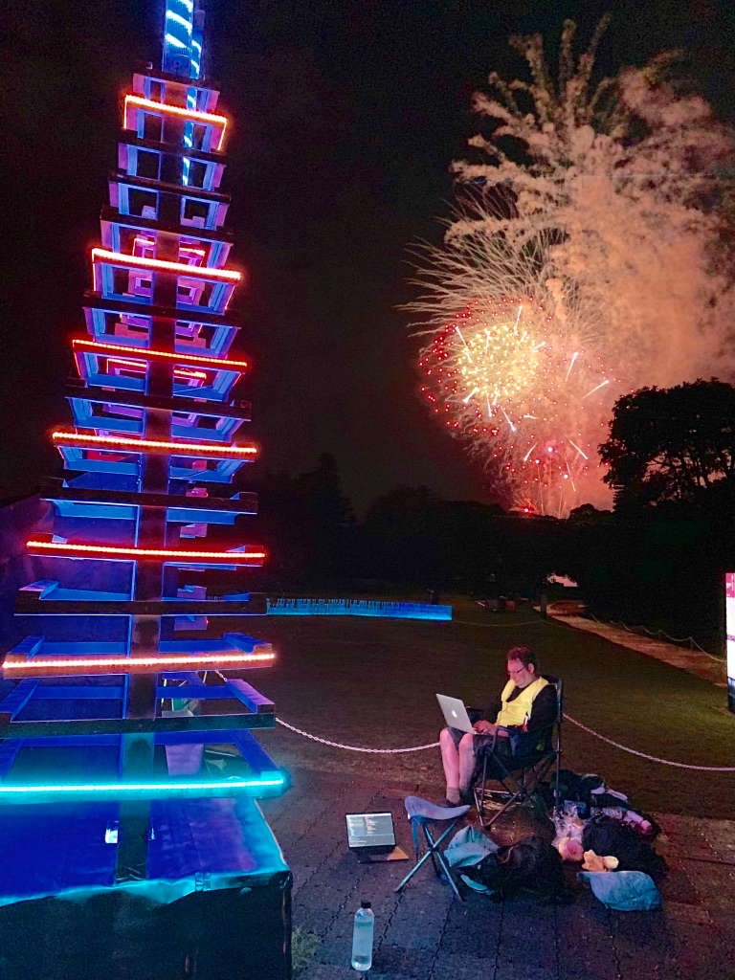
Perhaps give this a go!
This was Vivid Sydney - July 2019
4 x 6m towers (at the Garden bar)
USB uDMX controller which could be controlled with a Pi
Actually was just USB - but easily SDI can control addressable LED light strips etc using a Pi

Slide 34
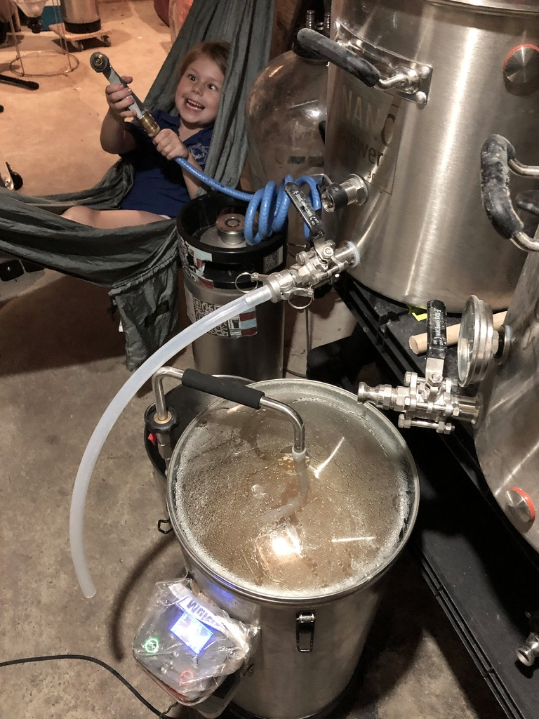
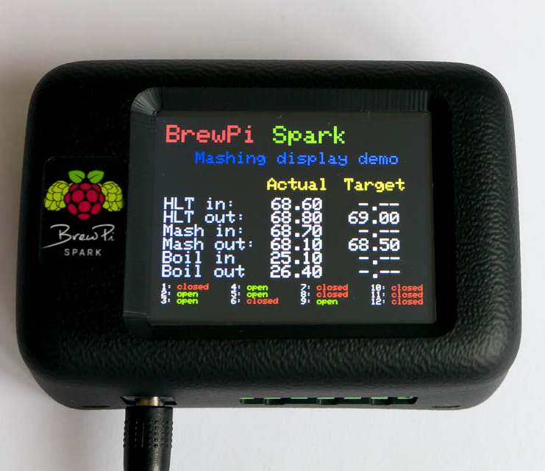
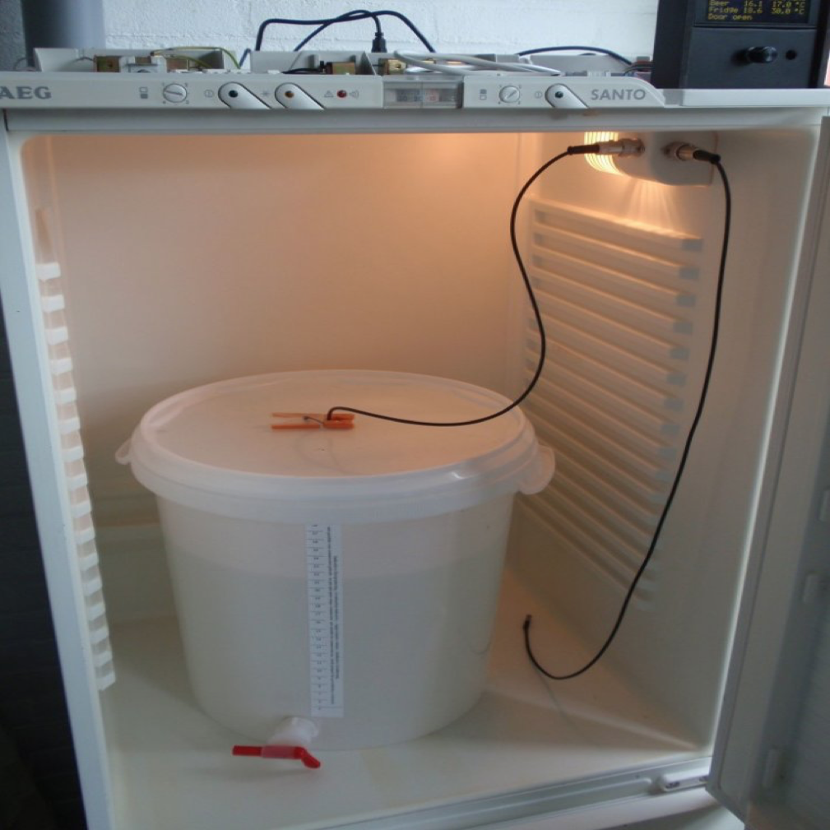
Could come in useful
BrewPi A modern brewery controller
The BrewPi Spark 3 is a temperature controller that can control your beer or wine fermentation with 0.1°C precision. It sends data to a Raspberry Pi to show a control panel with graphs in your browser.

Slide 35
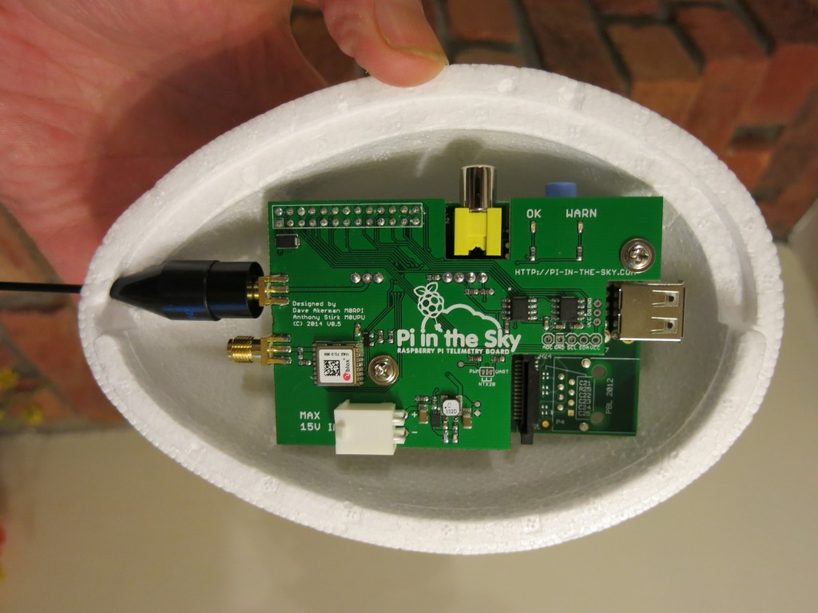
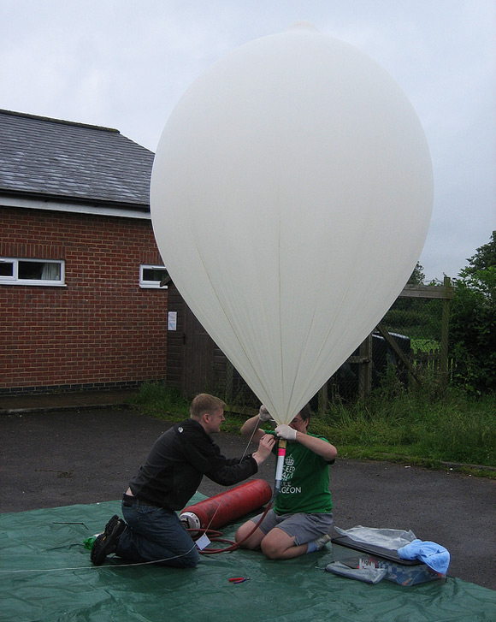
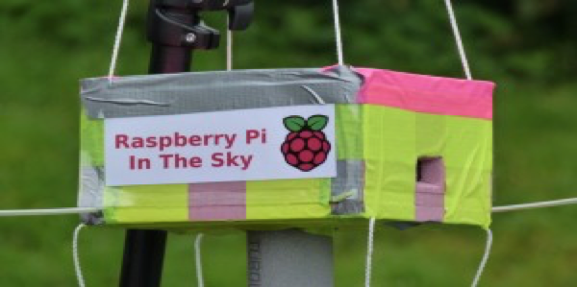


Decide for yourself if the Earth is flat or round
PiPeople Alan Mycroft, Eben,Rob Mullins, Pete Lomas, Logo, Jack Lang, Dave Braben

Slide 36
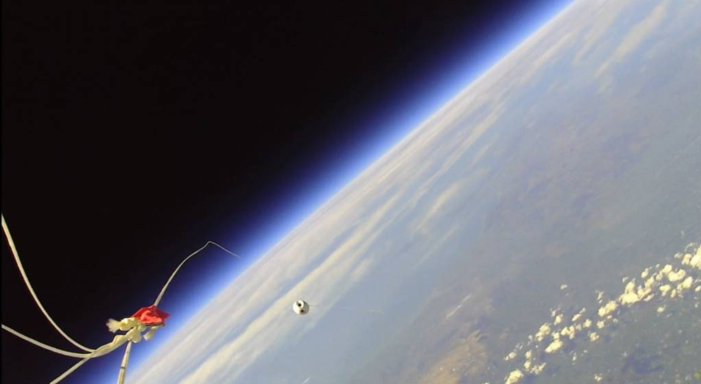
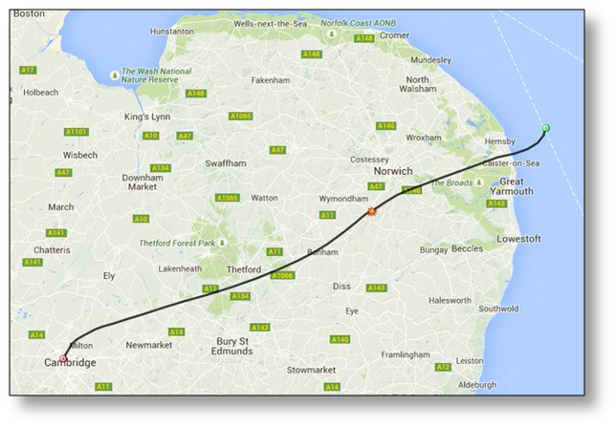
Decide for yourself if the Earth is flat or round
(Pi in the Sky - photo credit Dave Akerman)

Slide 37
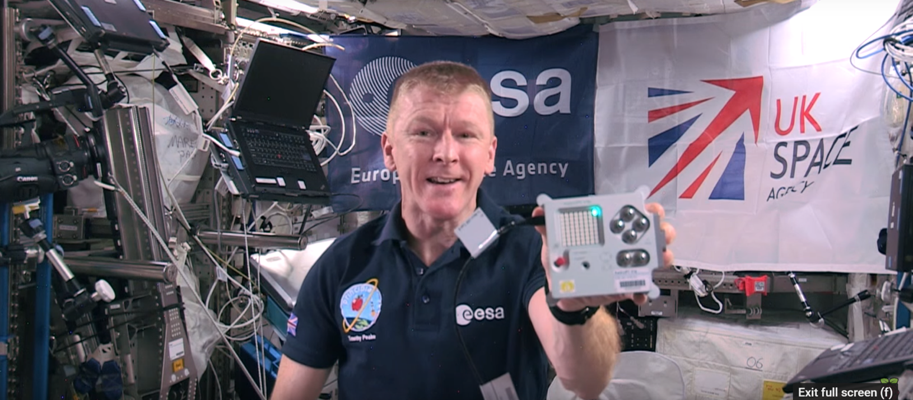

Or run your code up here (AstroPi with Tim Peake on ISS)

Slide 38



Or run your code up here (RasPi + SenseHAT - photo credit ESA)
Two AstroPi's on the ISS
Ed - visible camera
Izzy - Infrared

Slide 39


But, please don't go and do this...
Bitcoin mining - a pretty disgraceful and blatant misuse of the Earth’s fragile resources - just a selfish waste - no, no, no

Slide 40



Who ya gonna call? (rastrack.co.uk map of registered Pi’s - help is out there!)
Every man and her dog (quite a few in Sydney actually)

Slide 41
Shallow dive into Linux device drivers userland
You can totally develop code on a Pi but typically how we do things is cross compile from a more capable machine
Cross compiling for ARM - kernel flags - firmware repo armv7 vs aarch64 - arm-linux-gnueabihf-ld KERNEL=kernel7 && make bcm2709_defconfig make ARCH=arm CROSS_COMPILE=arm-linux-gnueabihf- menuconfig #hard float
User space abstractions to framebuffer / DirectFB / Wayland Using OpenMAX - Open GLES Audio too - SDL2 / Alsa

Slide 42

BuildRoot (rolling your own distro from scratch)
Kernel - bcm2709_defconfig BusyBox µClibc
Raspberry Pi isn't so resource constrained to really need to do this glibc works fine

Slide 43

Google ChromeOS aarch64 (arm64-generic)
Make your own Chromebox!
Chromium OS on a Pi
cros_sdk -- ./build_packages --board=rpi3 cros_sdk -- ./build_image --board=rpi3 cros flash usb:// rpi3/latest
Check out FydeOS

Slide 44

Microsoft Window 10 (IoT edition)
Quick bring up
Working with WinCE nostalgia
Number of ARM compiled apps remains fairly limited
But nothing stopping you compiling your own!

Slide 45

Remembering RiscOS
Many UK kids will have used RiscOS (possibly unknowingly)
Quick bring up of RiscOS
I had my school buy the full documentation set!
(and yes I read them ;-)
Happy days

Slide 46
Thanks!
You may have noticed I’m still working on these slides
but the final set will be here:
http://bit.ly/2vr4Hws

